Slide 1
Animal Encounters
Animals are all around us and people have been using them in art for thousands of years.
Here is a selection of animals in the Williamson collection.

Slide 2
You will see each picture before you see the title. Think about these questions for each one before you see the title.
Are there any people in the picture?
Who do you think the people are?
What else can you see in the picture with the animals?
Where do you think the picture is set?
Do you think the animals in the picture are wild or tame?
How do you think the picture was made?
Do you like the picture?
Does seeing the titles help you to answer the questions?

Slide 3
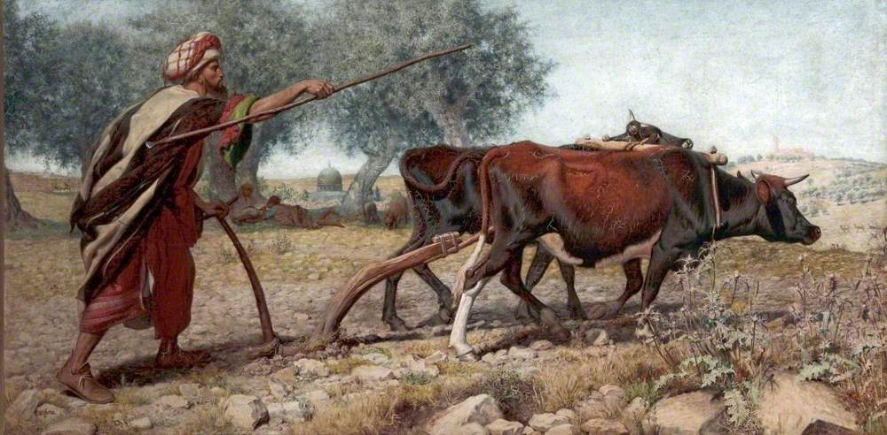
Ploughing Mount Sion by William Webb

Slide 4
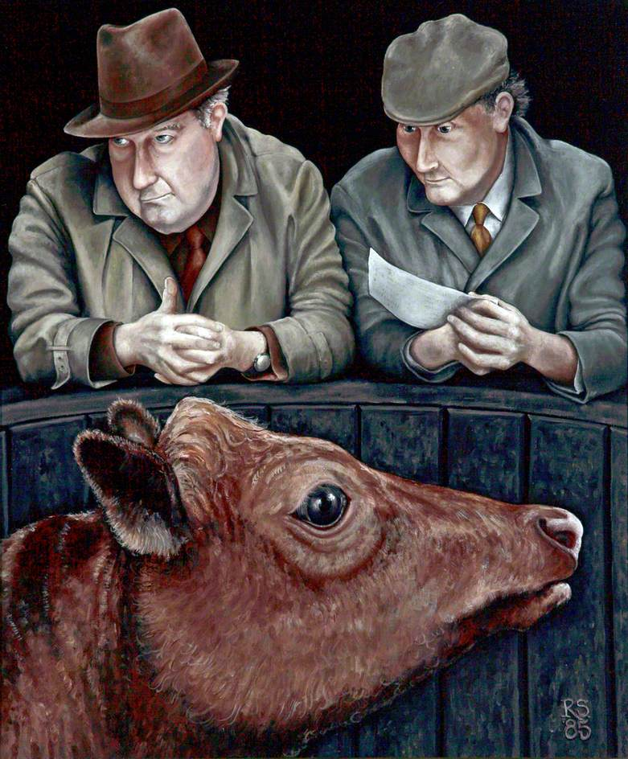
Auction
by Rob Symington

Slide 5
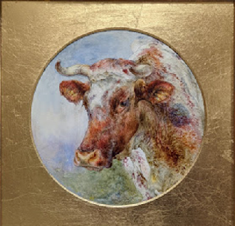
Head of a Cow
by William Huggins

Slide 6
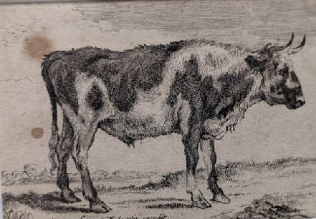
The Young Bull by Frederick de Wit

Slide 7
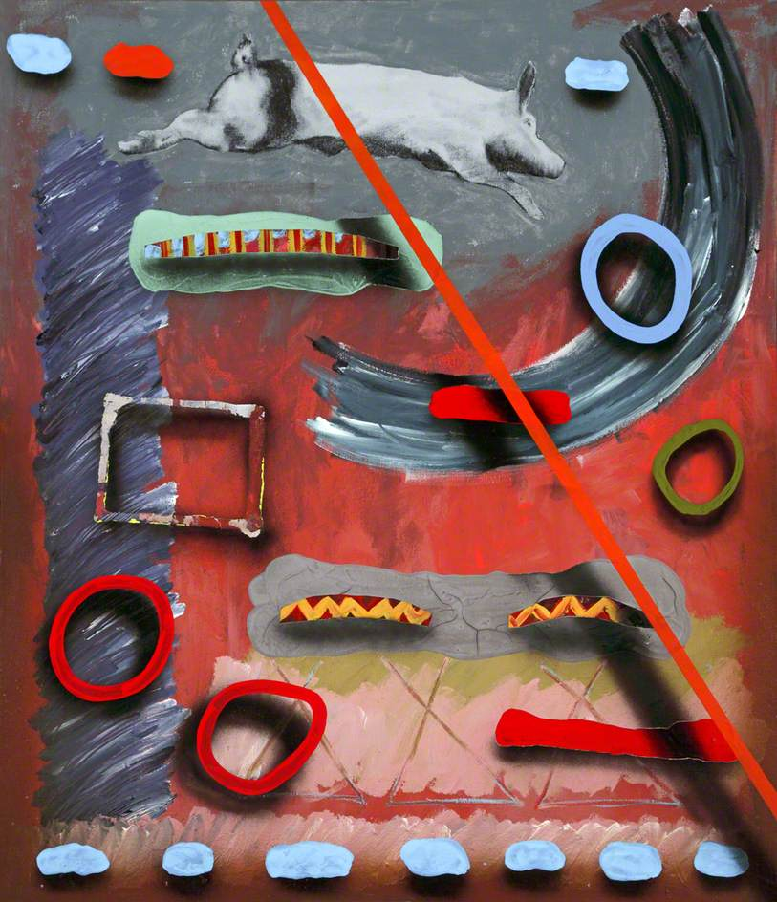
Countdown Pig by
Stephen Vicary

Slide 8
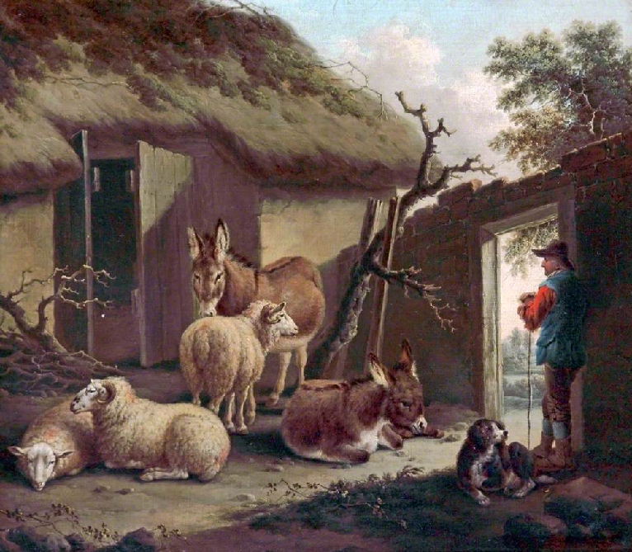
Yard with
Donkeys and Sheep
by Charles Towne

Slide 9
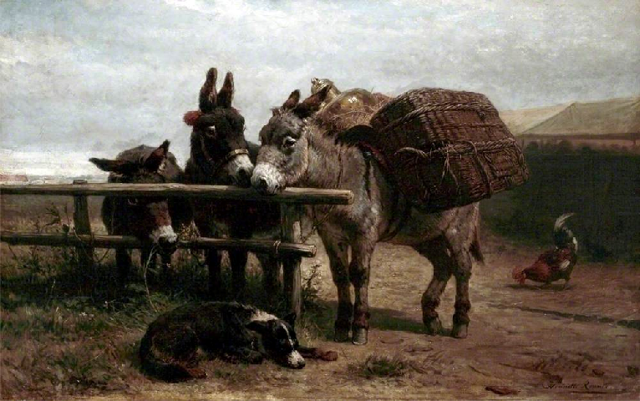
Intimate Friends by Henriette Ronner

Slide 10
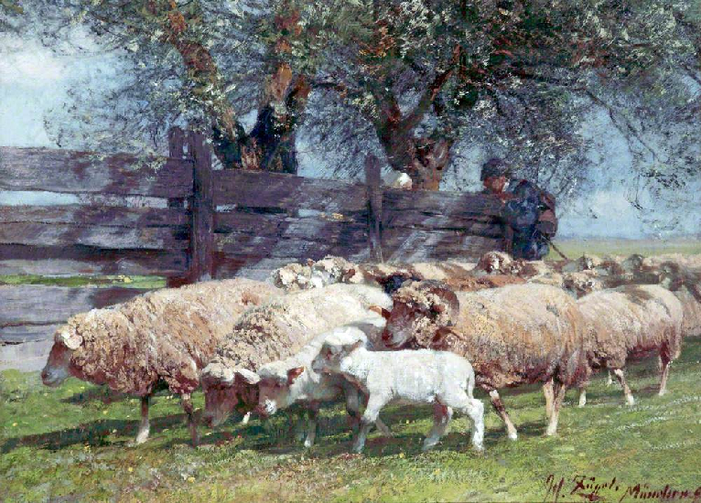
Herding Sheep by Heinrich Johann von Zügel

Slide 11
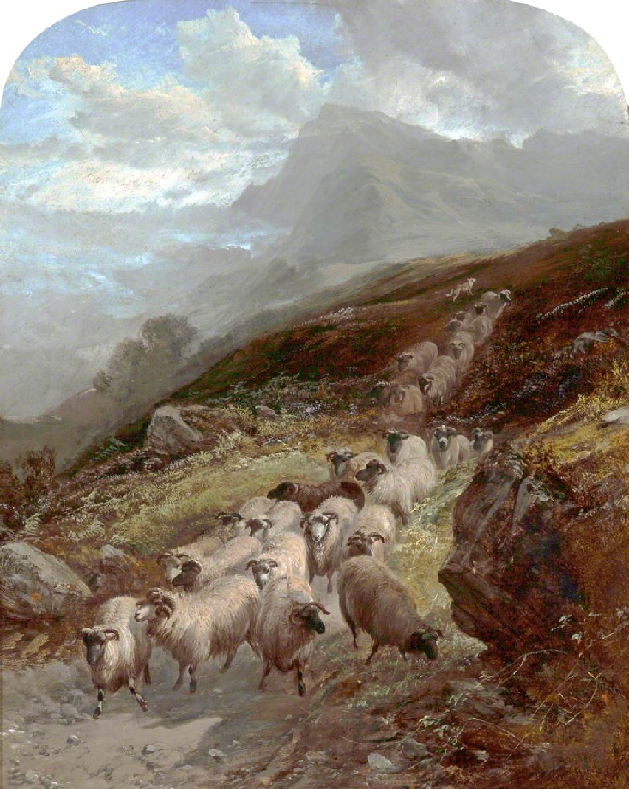
Sheep on a Mountainside
by William Watson

Slide 12
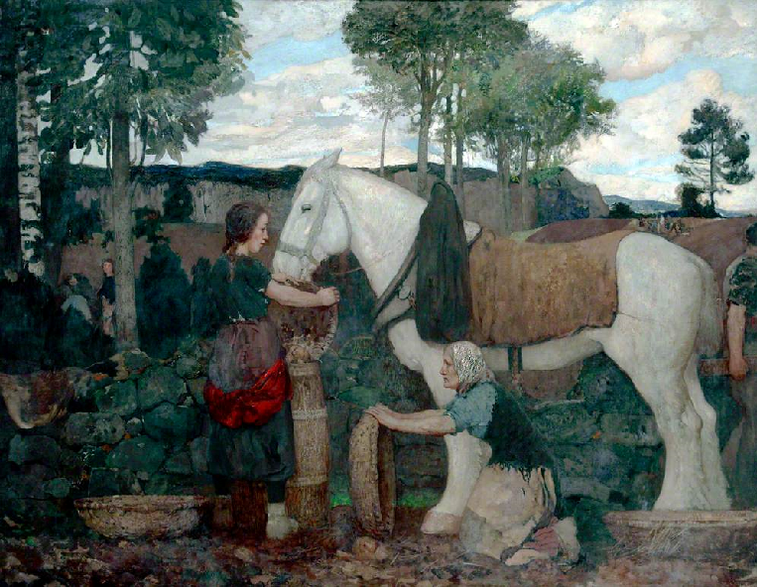
Field Life
by David Forrester Wilson

Slide 13
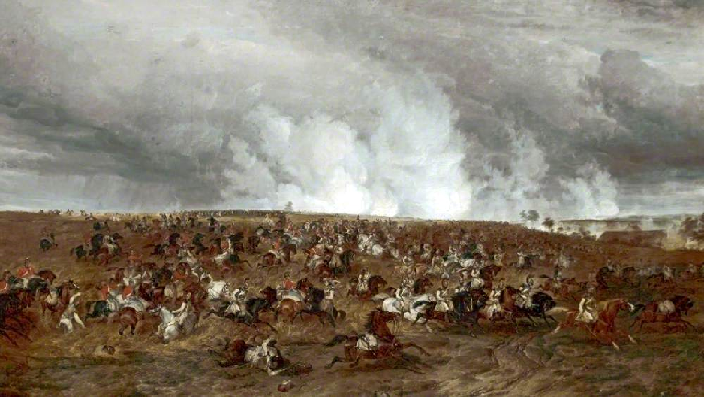
The Battle of Waterloo, 16–19 June 1815, the Defeat of Kellerman's Cuirassiers By Thomas Sidney Cooper

Slide 14
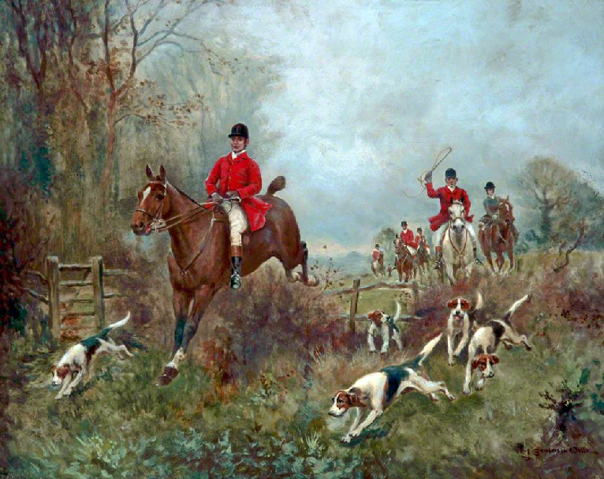
In Full Cry
by J Sanderson-Wells

Slide 15
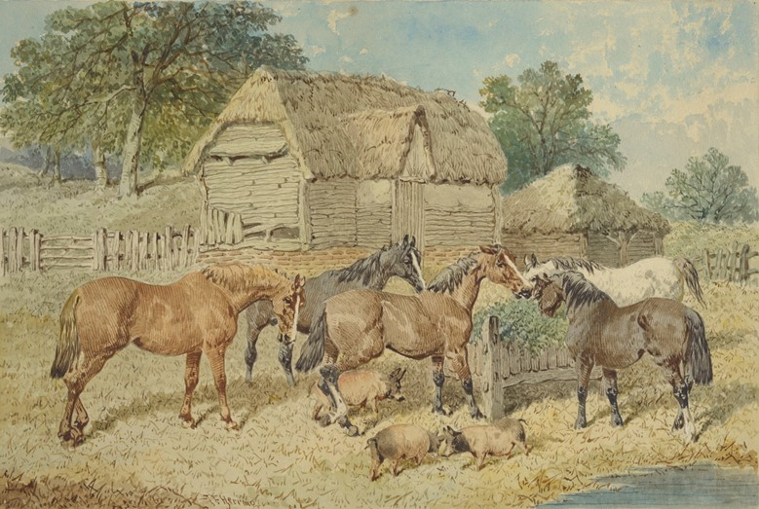
Group for Captain Towneley’s Picture by John Frederick Herring

Slide 16
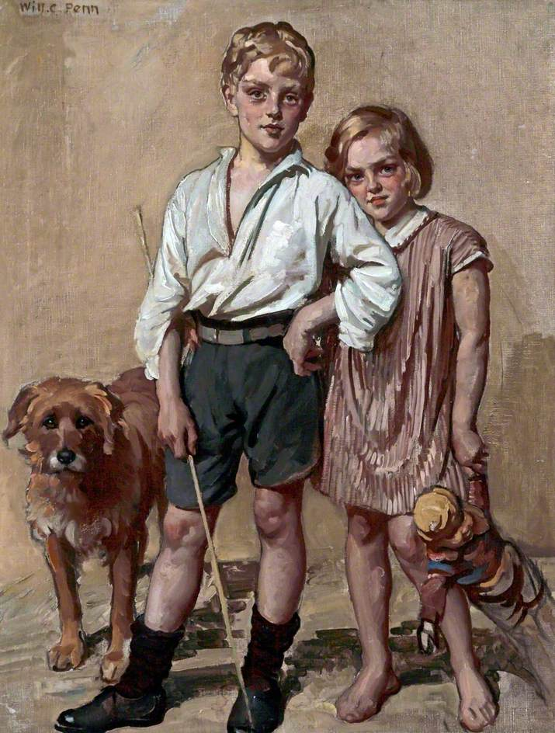
The Good Companions (Arthur and Dora)
by William Charles Penn

Slide 17
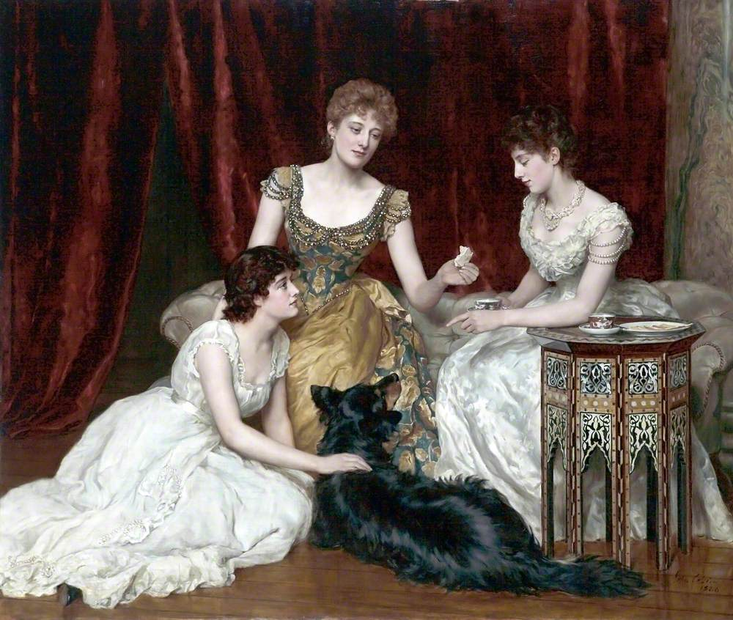
The Three Daughters of William Reed by Hon. John Collier

Slide 18
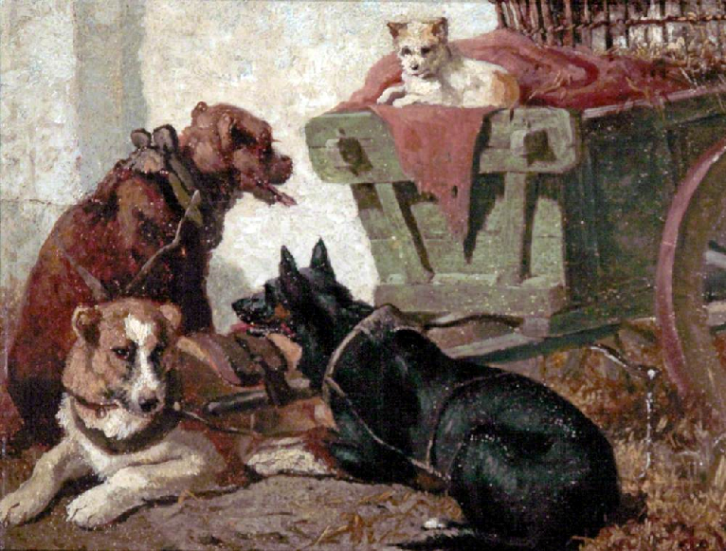
The Dog Cart
by Vincent de Vos

Slide 19
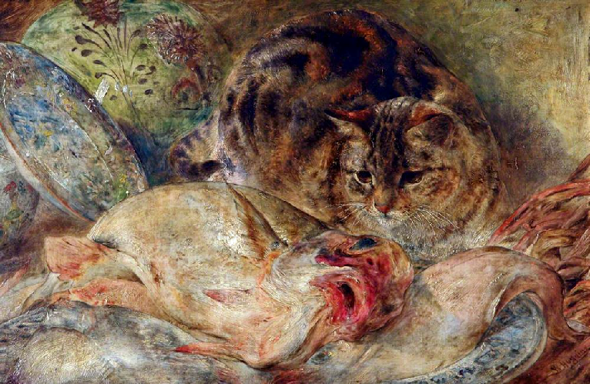
Cat and Fish by William Huggins

Slide 20
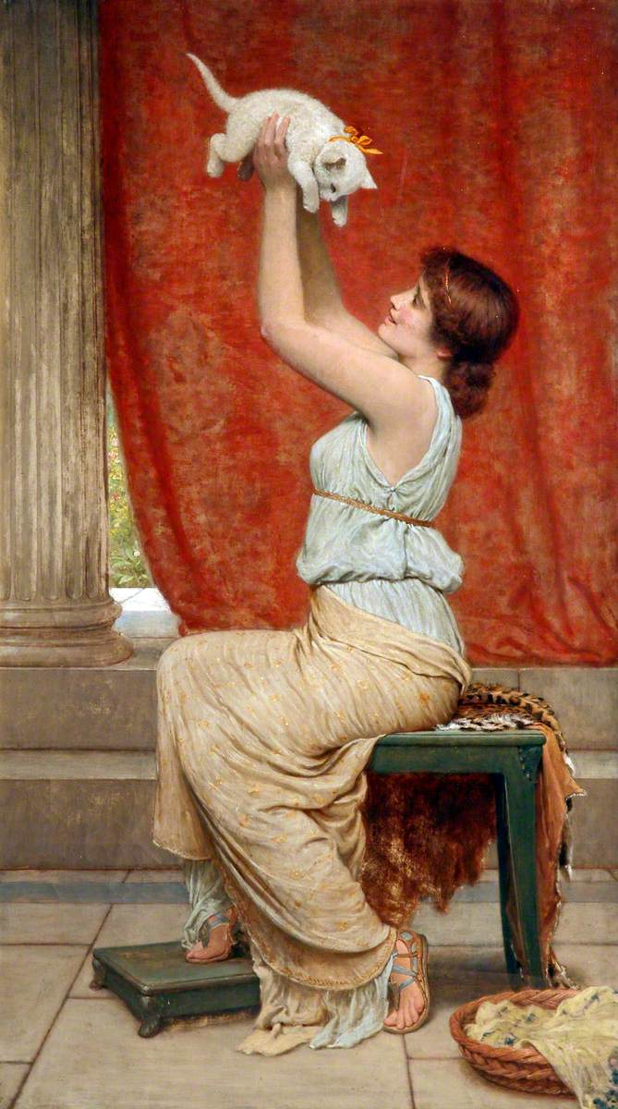
At Play
by Charles Edward Perugini

Slide 21
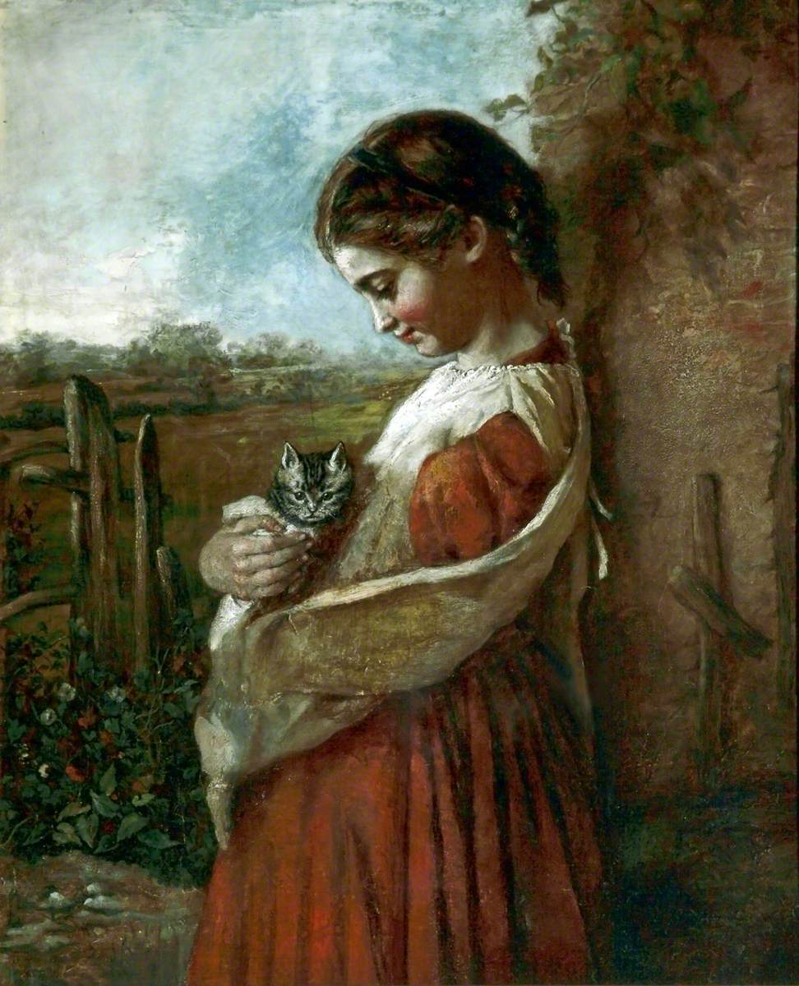
Girl and Cat
by Florence Banner

Slide 22
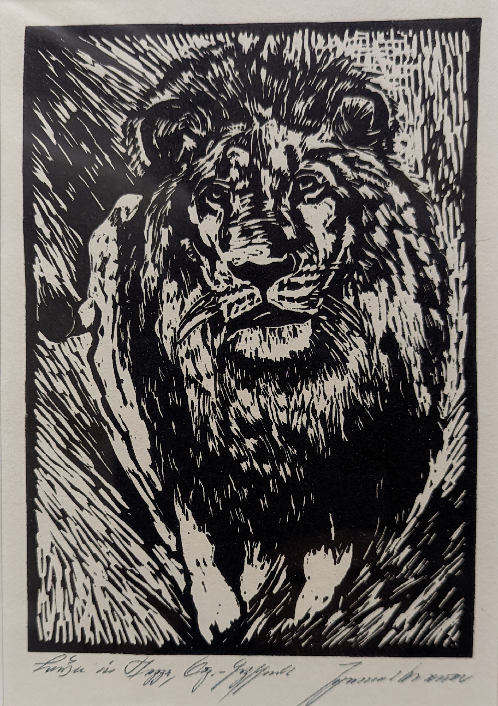
The King of Beasts
by Johannes Brauer

Slide 23
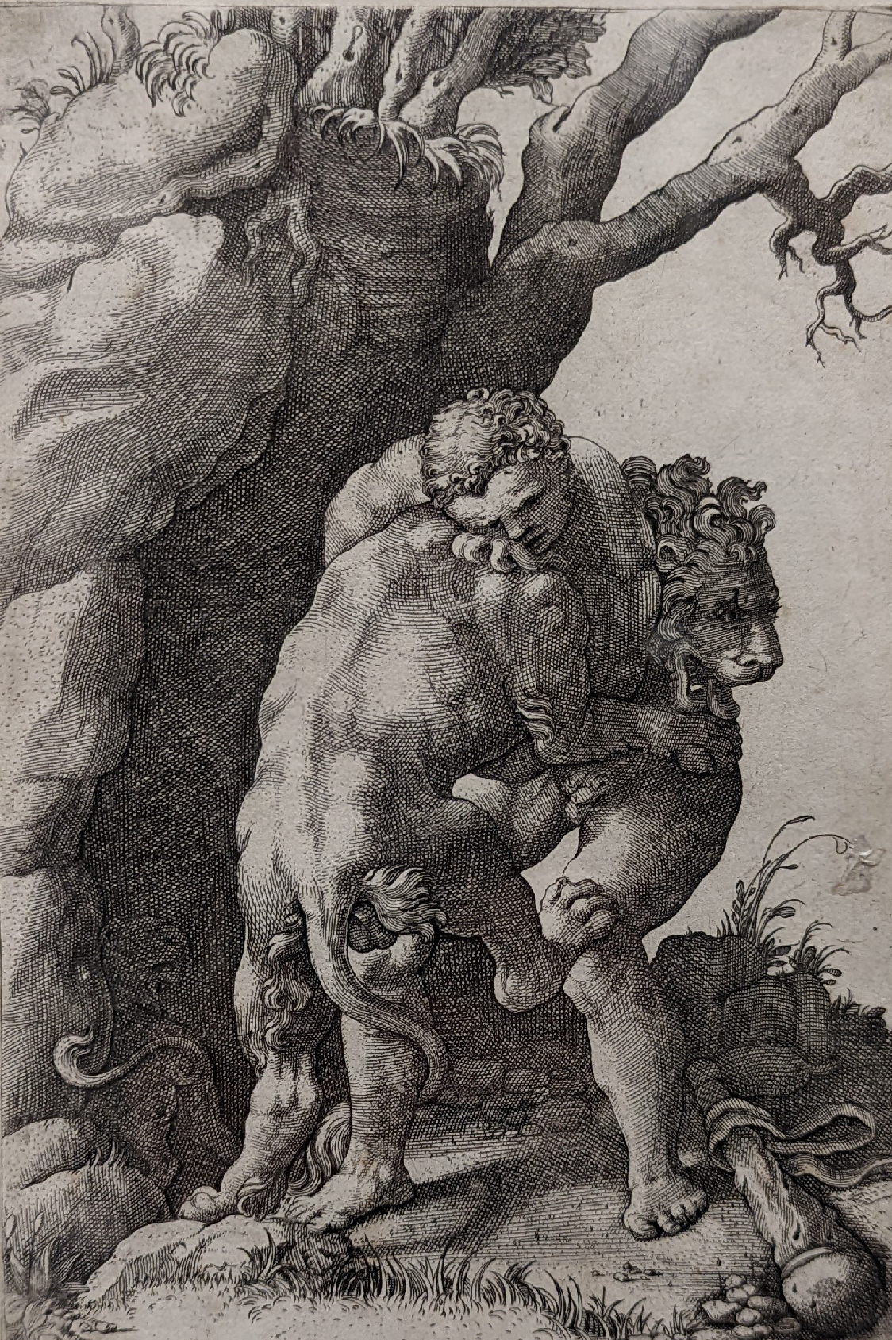
Hercules and the Nemean Lion by Diana Mantuana

Slide 24
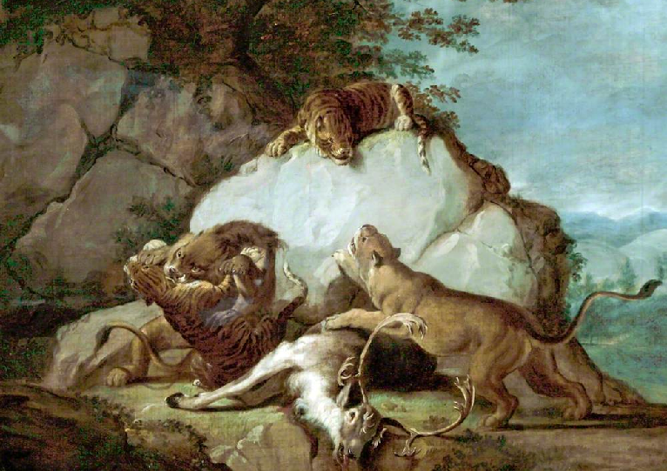
Lion and Tigers Fighting a Stag attributed to George Stubbs

Slide 25
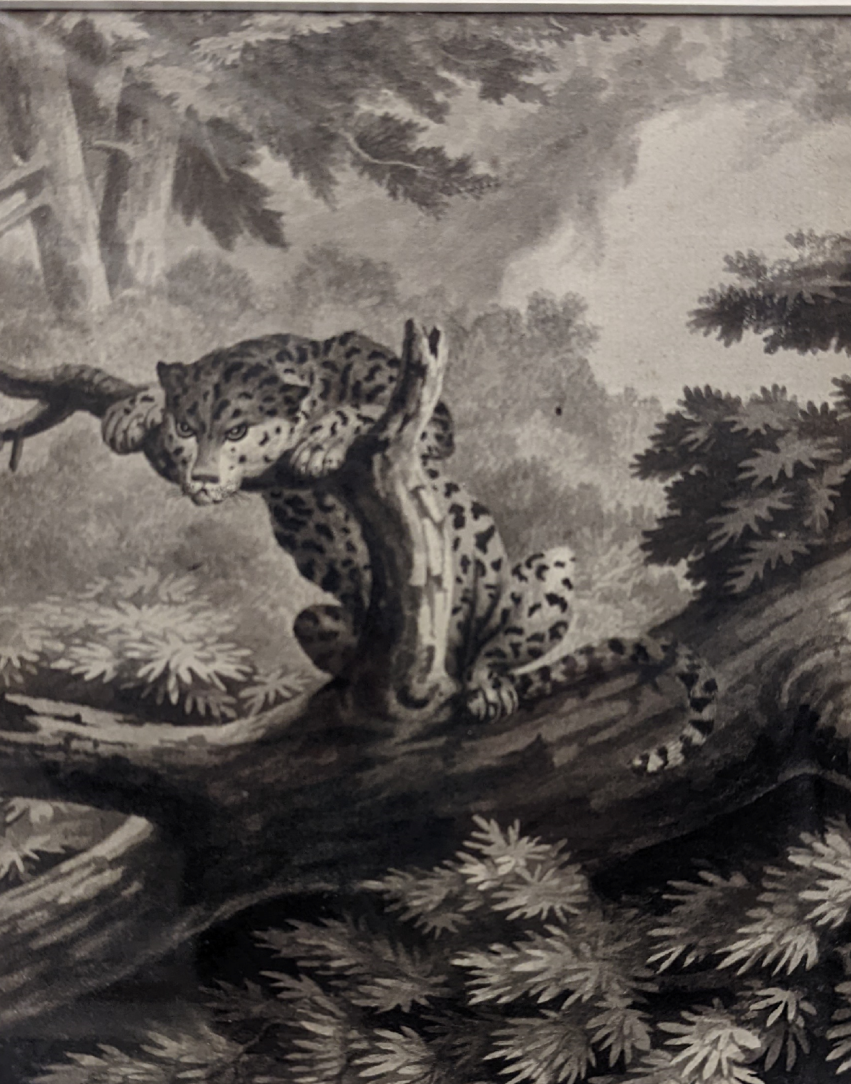
Leopard
by James Ward

Slide 26
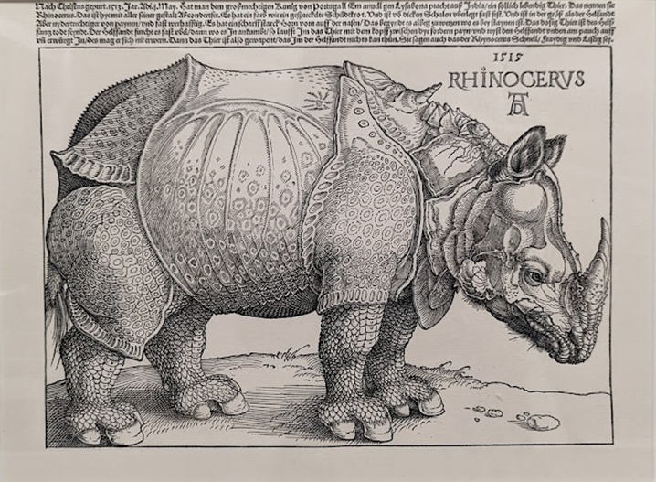
Rhinoceros
after Albrecht Durer

Slide 27
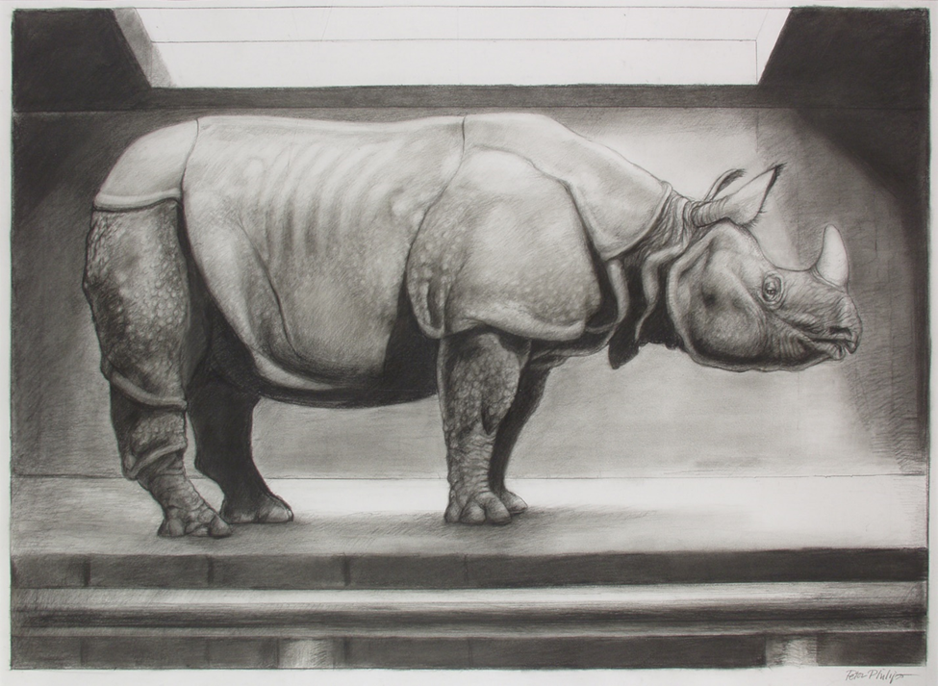
A New Bestiary: Asian Rhinoceros by Peter Philip

Slide 28
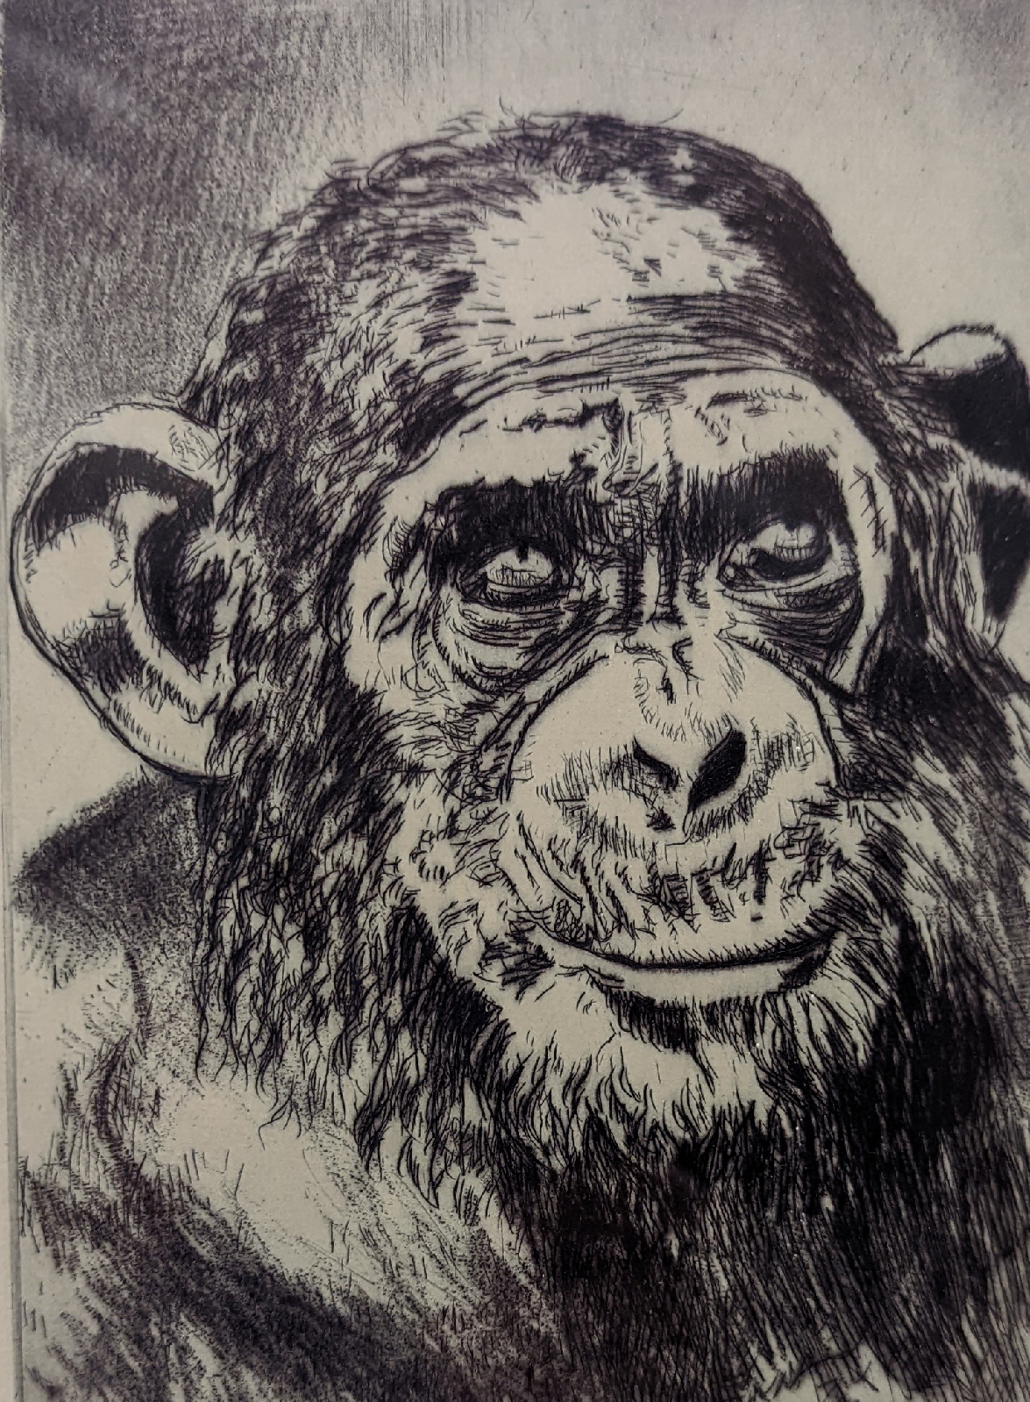
Chimpanzee
by Johannes Brauer

Slide 29
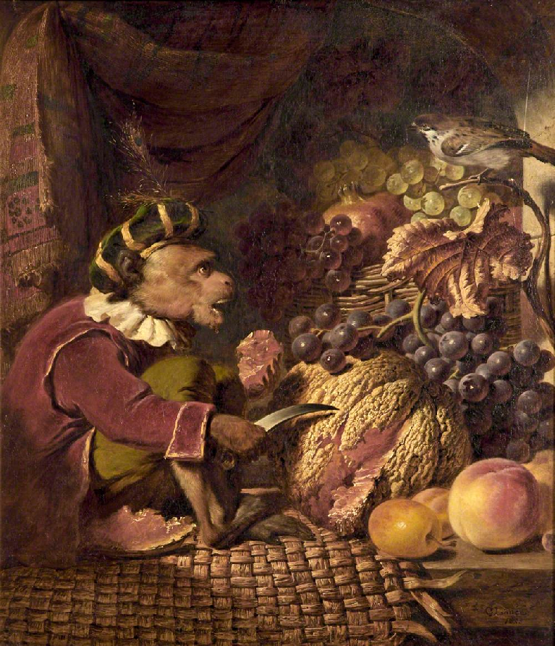
Jocko at Lunch by George Lance

Slide 30
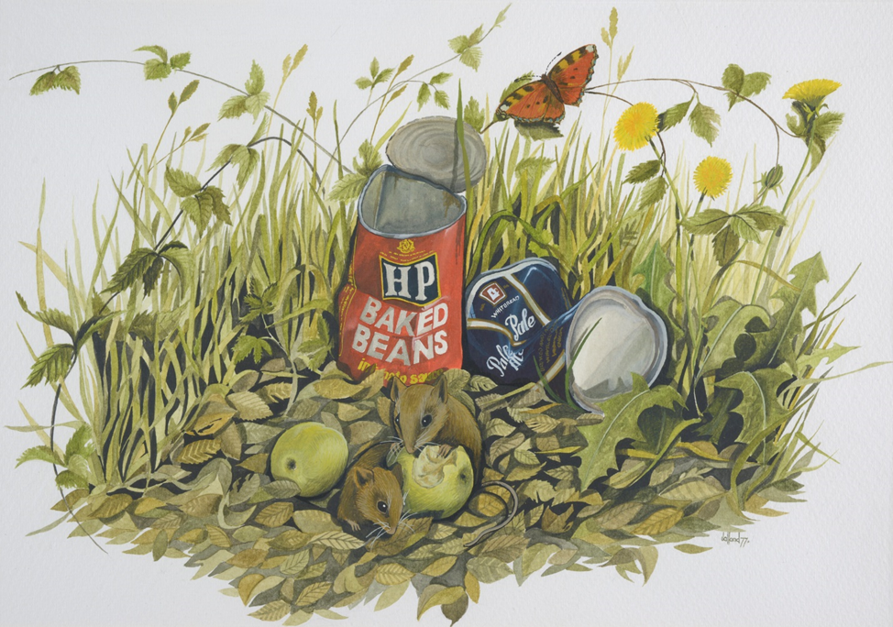
The Picnic
by Tony Jalland

Slide 31
The Mouse by Stephen Gooden

Slide 32
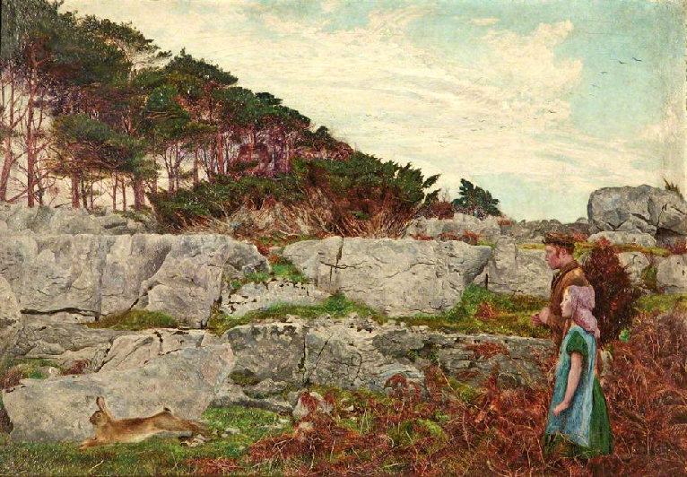
The Startled Rabbit
by Daniel Alexander Williamson

Slide 33
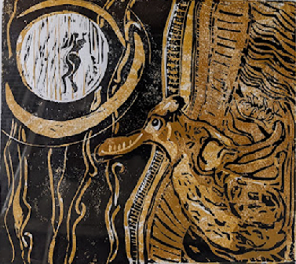
Hare’s Dream 2 by Susan Lee Brown

Slide 34
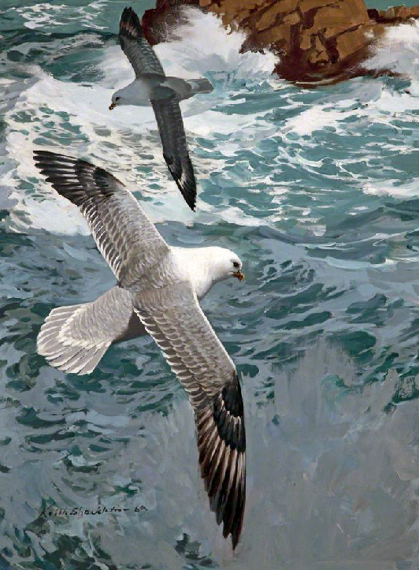
Fulmars around the Skerries
by Keith Shackleton

Slide 35
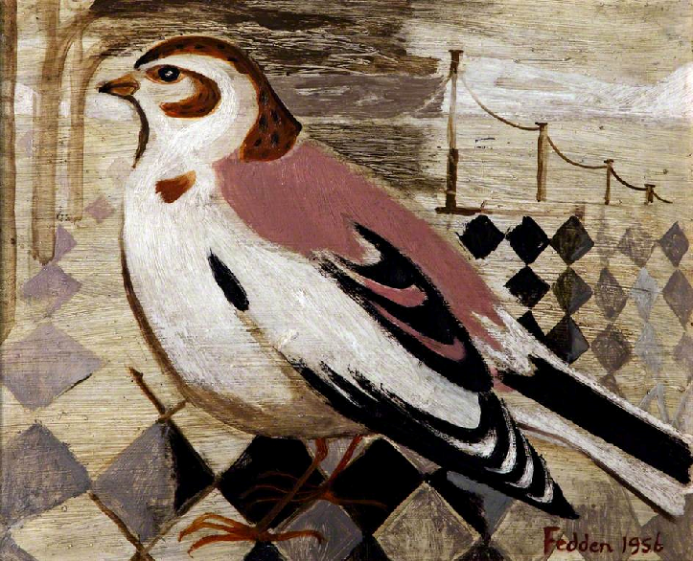
Snow Bunting
by Mary Fedden

Slide 36
Which picture was your favourite?
Why?

