Slide 1
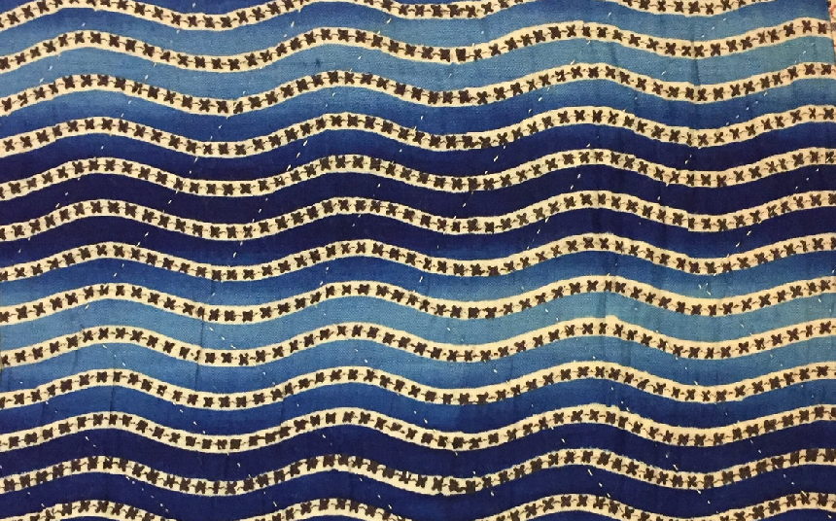
Pattern at the Williamson

Slide 2




What is pattern?
Pattern is a repeated decorative design.
Here are some examples...

Slide 3

Types of pattern
Some patterns have names.
Do you know the names of some patterns?
Do you know what this pattern is called?
These are stripes.
Did you know that?

Slide 4

What is this one called?
These are spots.
Another name for spots is dots, or polka dots.

Slide 5

How about this one?
This pattern is checks or checkers.
Do you know any games that are played on a board like this?

Slide 6
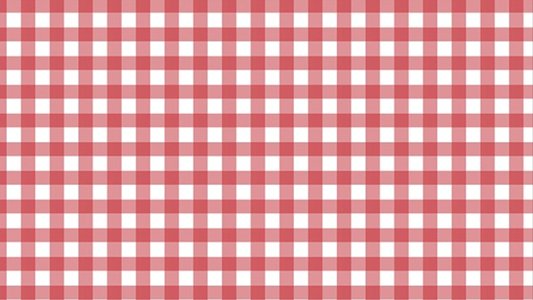
Do you know this one?
This pattern is called gingham.
Lots of schools have summer dresses for the girls made from gingham.

Slide 7
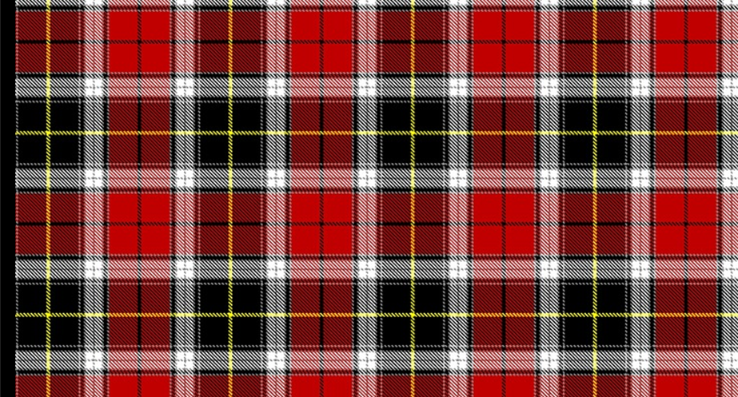
What do you think this one is called?
This pattern is called tartan.
Tartan comes from Scotland.
Traditionally, each family, or clan, had their own design of tartan.

Slide 8
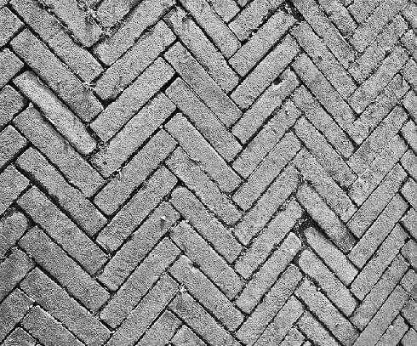







Here are some more patterns with names…
…and some of the names are quite strange!
Herringbone
Houndstooth check
Argyle
Paisley
Chevron
Quatrefoil
Basketweave
Honeycomb

Slide 9
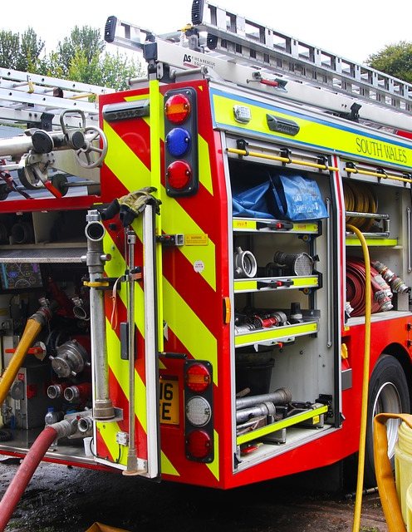


Patterns can be useful.
Why do you think the fire engine has such bright red and yellow stripes?
Who wears this sort of pattern? How is it useful to them?
What does it mean if there are black and white stripes across a road?

Slide 10

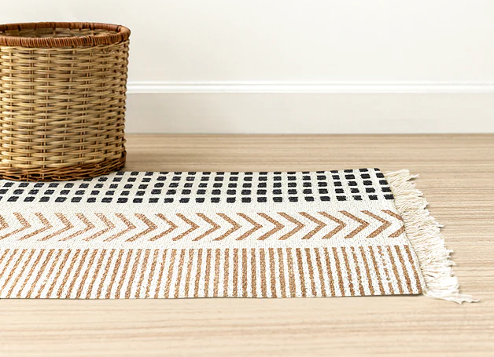

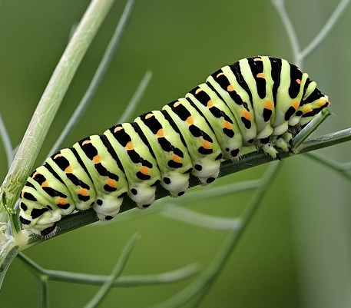
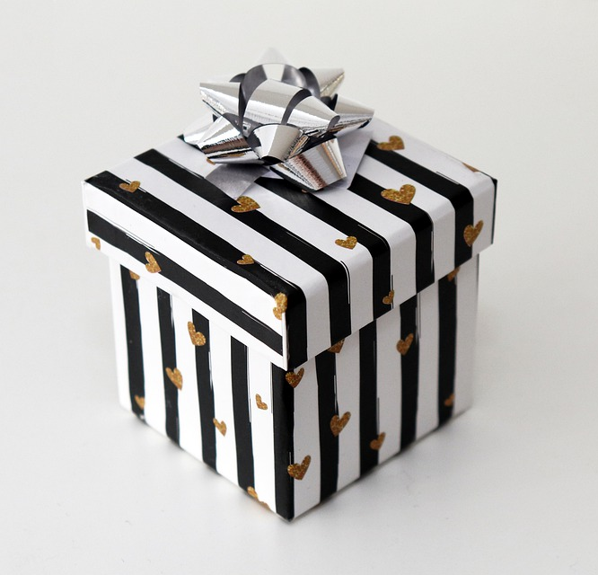
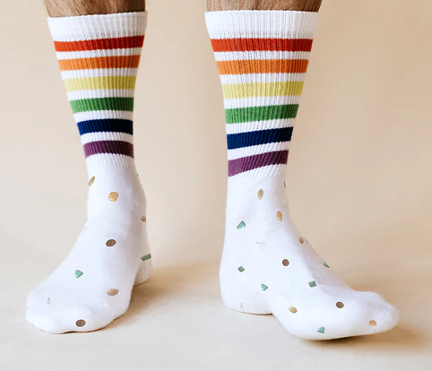

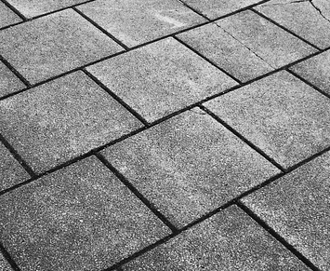
There are patterns all around us...
…in sport
…on our floors
…on our dishes
…in nature
…on gifts
…on our clothes
…in our buildings
…in our towns

Slide 11
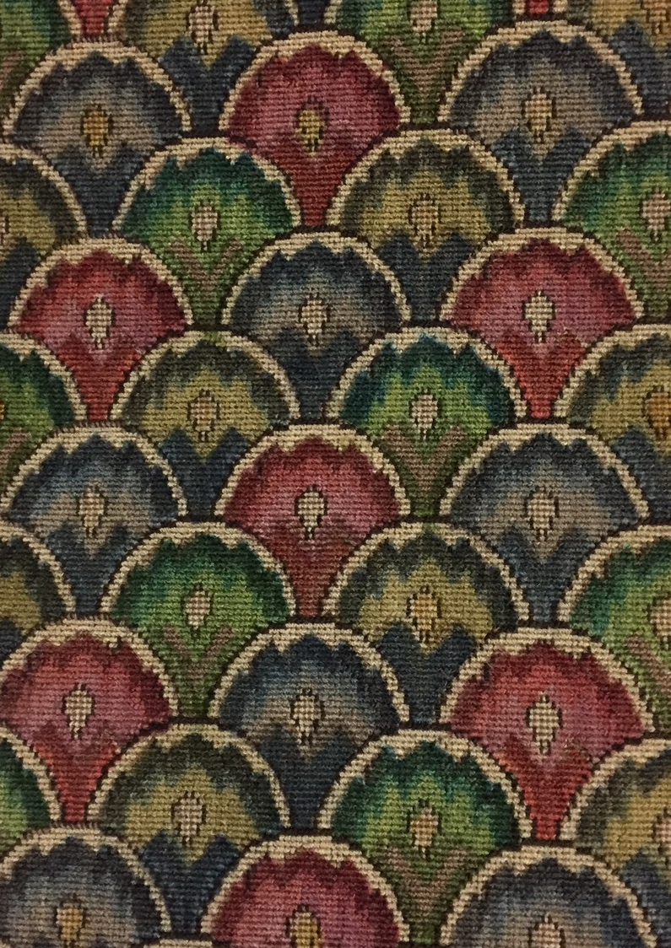
Let’s take a look at how pattern has been used the collection at the Williamson Art Gallery and Museum…

Slide 12
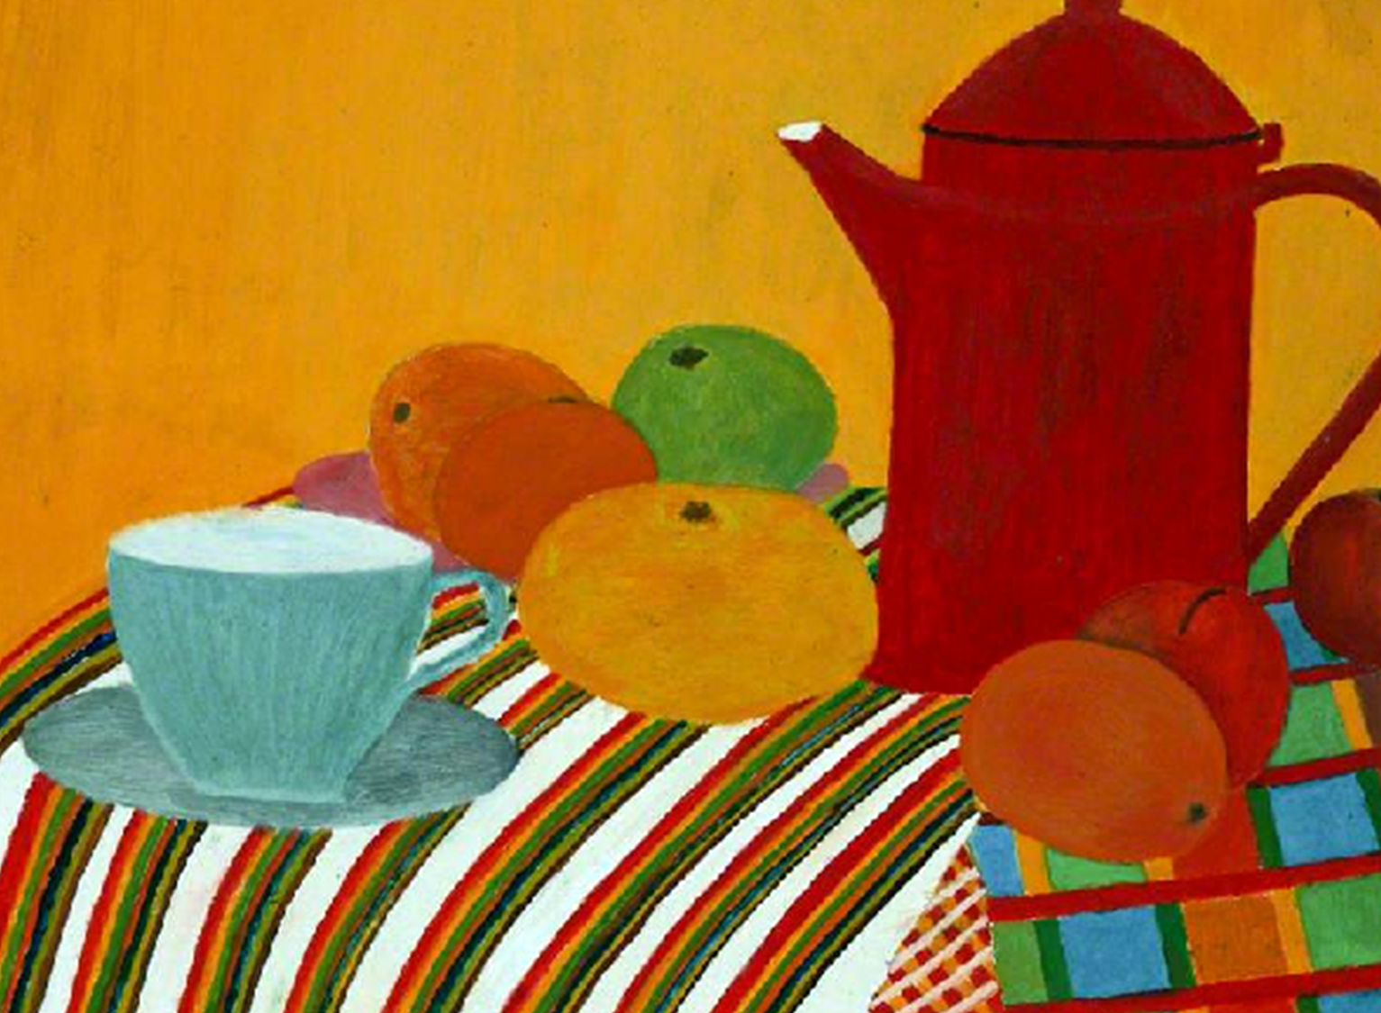
This is
Still Life
by R Jackson
How many patterns can you see?
Which of the patterns is your favourite?
Why?

Slide 13
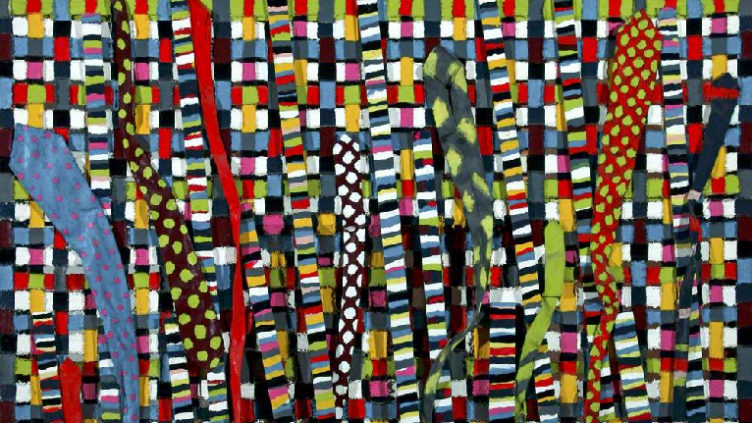
This is
Snakes and Ladders by Alan Hughes
Why do you think this painting is called Snakes and Ladders?
How many different patterns can you see?
Which item of clothing is used in the picture?

Slide 14
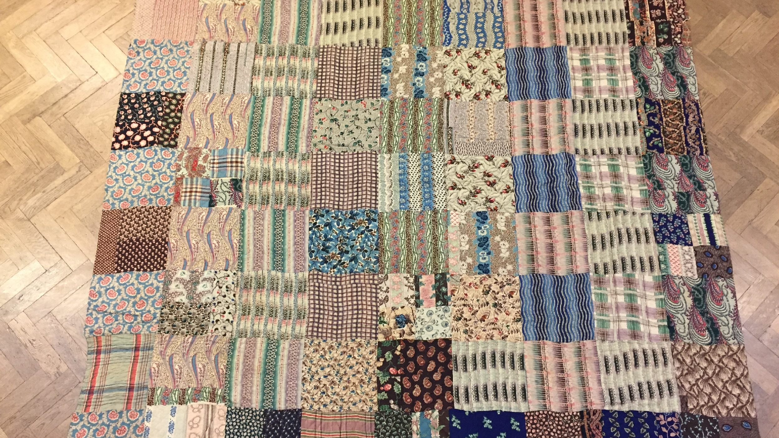
This is a very old patchwork quilt, made from pieces of fabric with lots of different patterns.
How many patterns can you see?

Slide 15
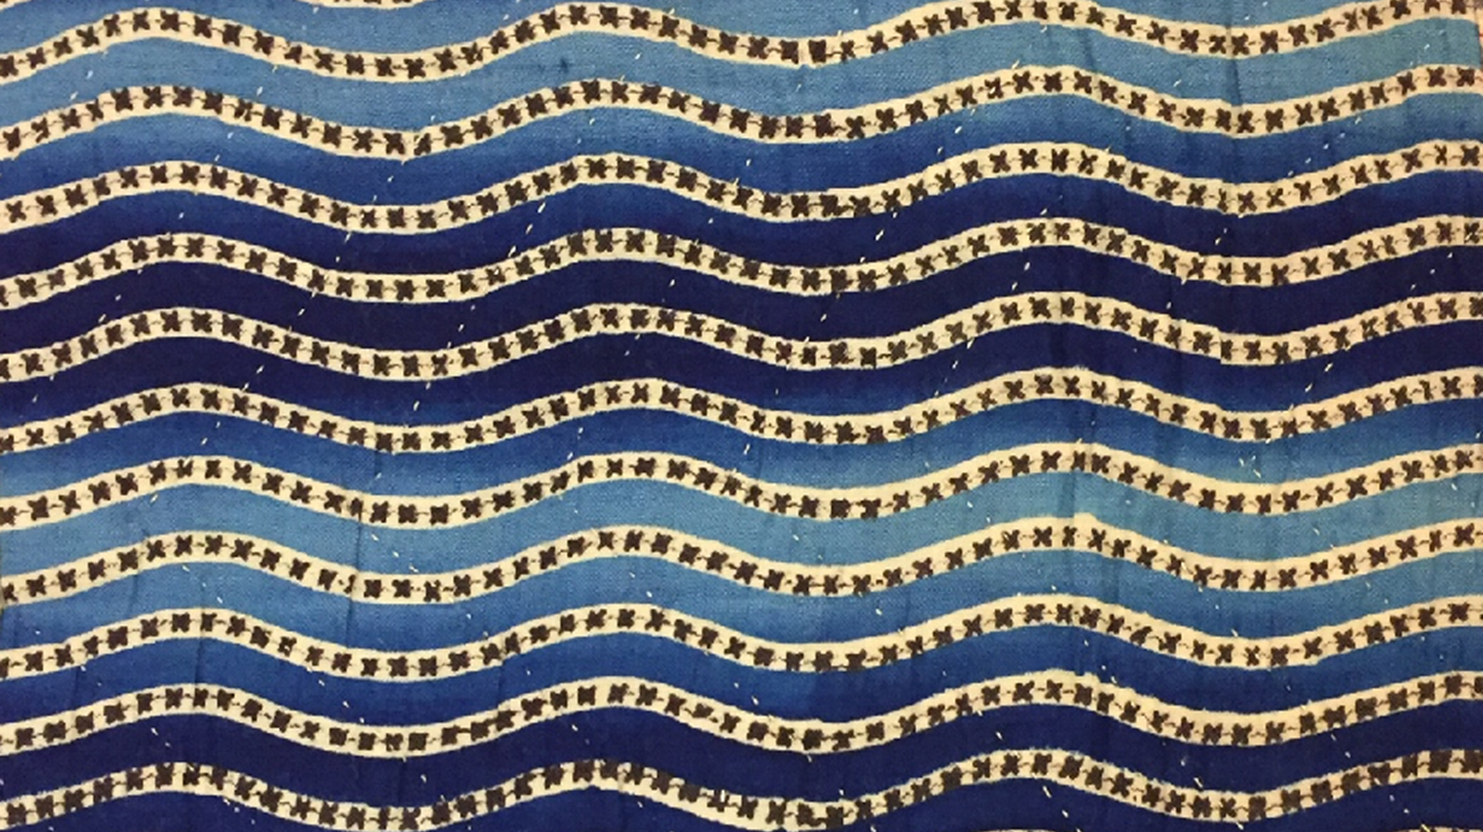
How many different patterns do you think you will see today?
See if you can remember the names of some patterns that you see.
Maybe you will create some patterns of your own…

